Slide 1
Image Mosaicing
By Jatin Keswani (16ucs081)
Preksha Pandey (16ucs139)

Slide 2
Objective
Creating a new image by stitching 6 separate images of the same blackboard to get the complete blackboard image

Slide 3
Introduction
Mosaicing is a technique to stitch images from the assembling of small pieces of separated images to get the whole image.
In mosaicing, we take minimum 4 points from each image to blend them to get a combined Image.

Slide 4
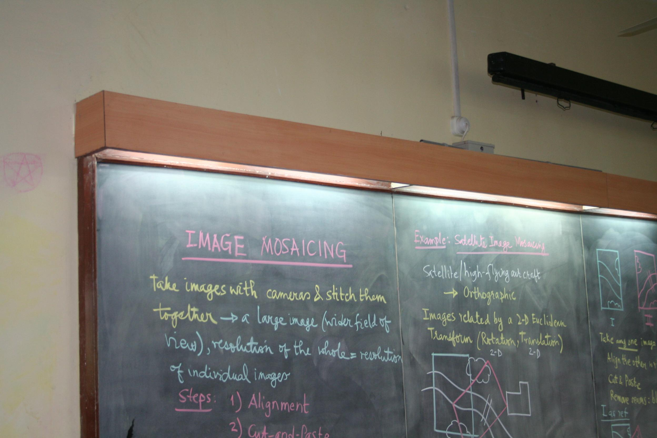
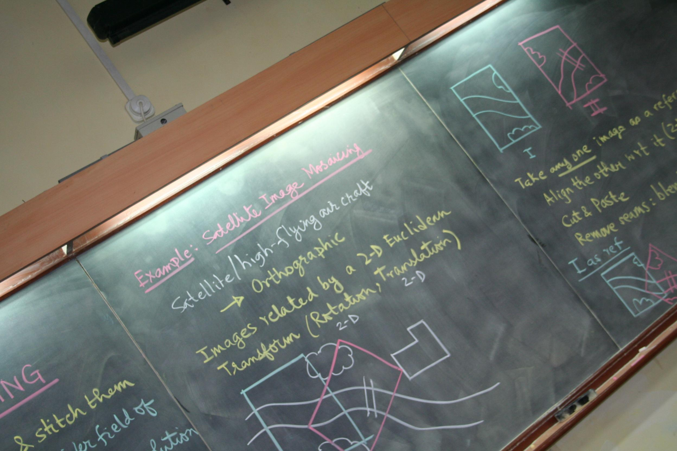
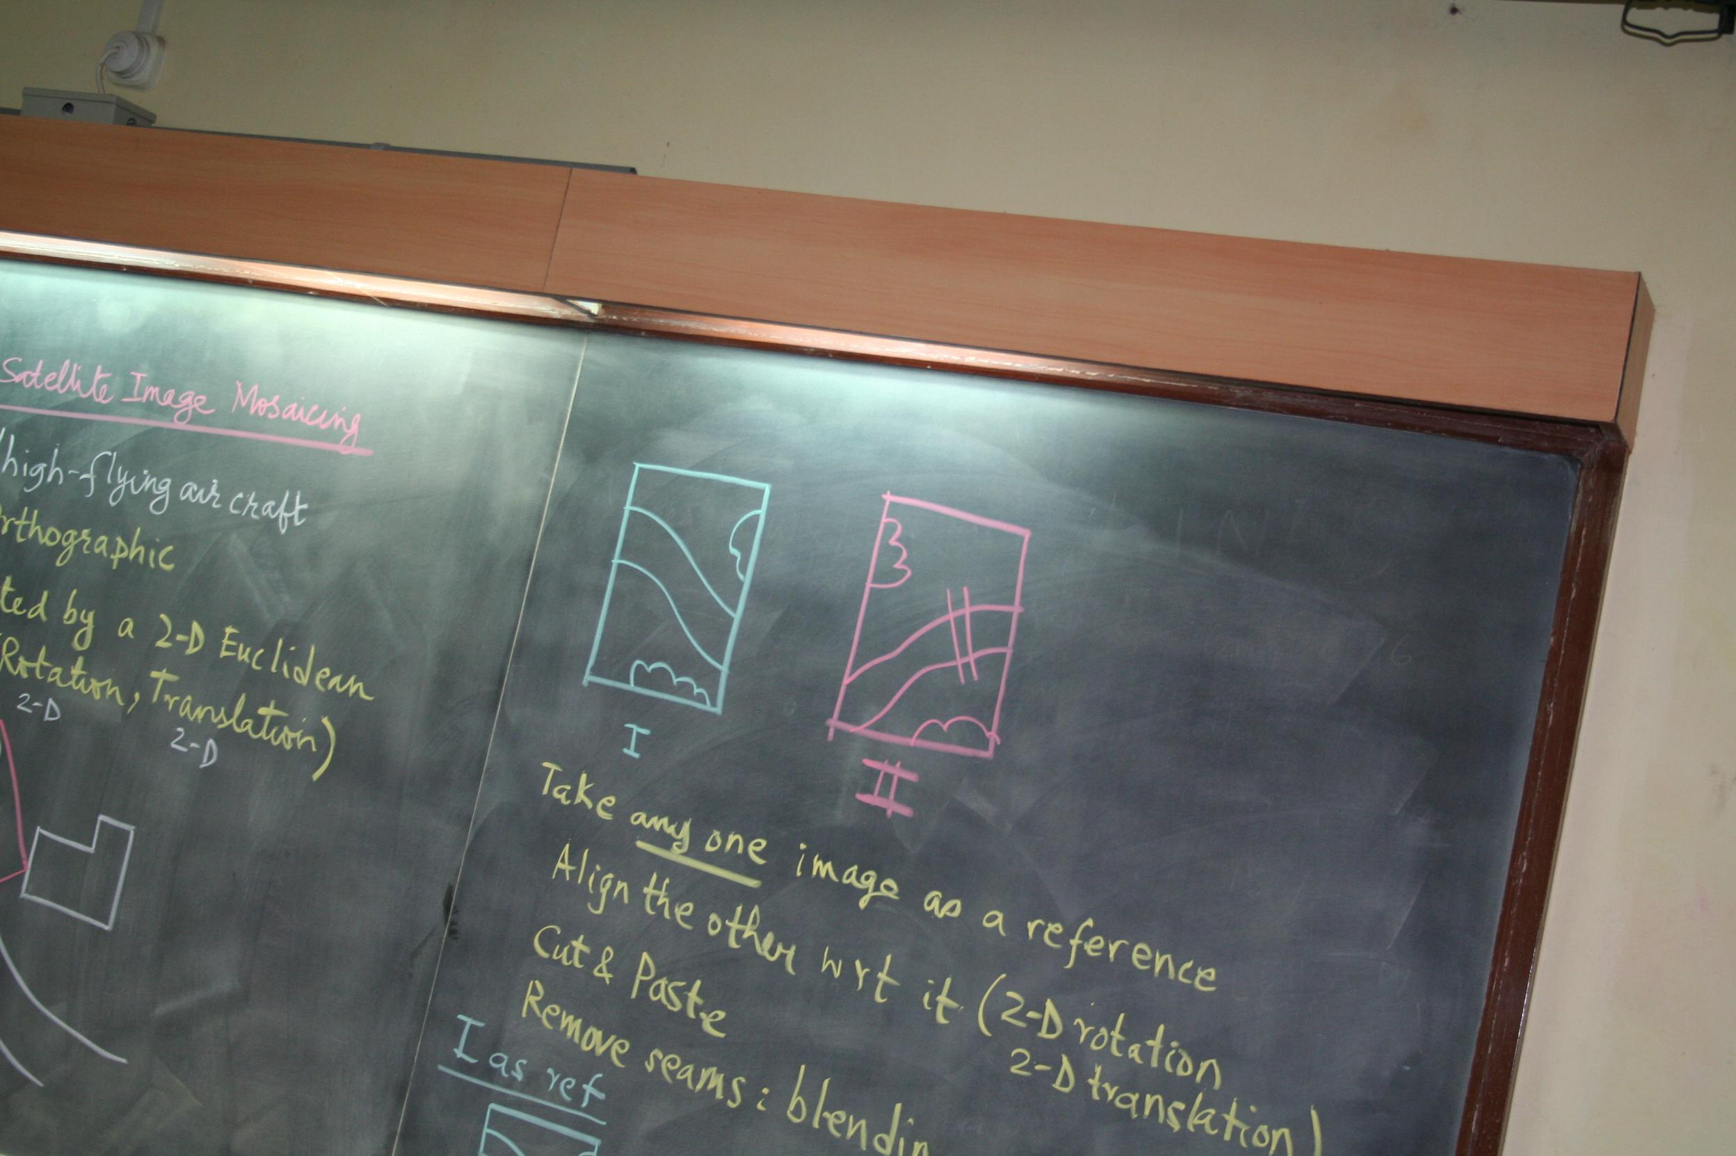
Procedure
Load the 6 images and get the corresponding points either from user or by hard coding them
We send the coordinates value (x1,y1,x2,y2) to Homography function
In Homography function, there is a A matrix whose output is used as an input in SVD function
From SVD we take the last matrix V and then take the last column and convert it into 3X3 HOMOGRAPHY matrix and return HOMOGRAPHY and INVERSE HOMOGRAPHY MATRIX

Slide 5
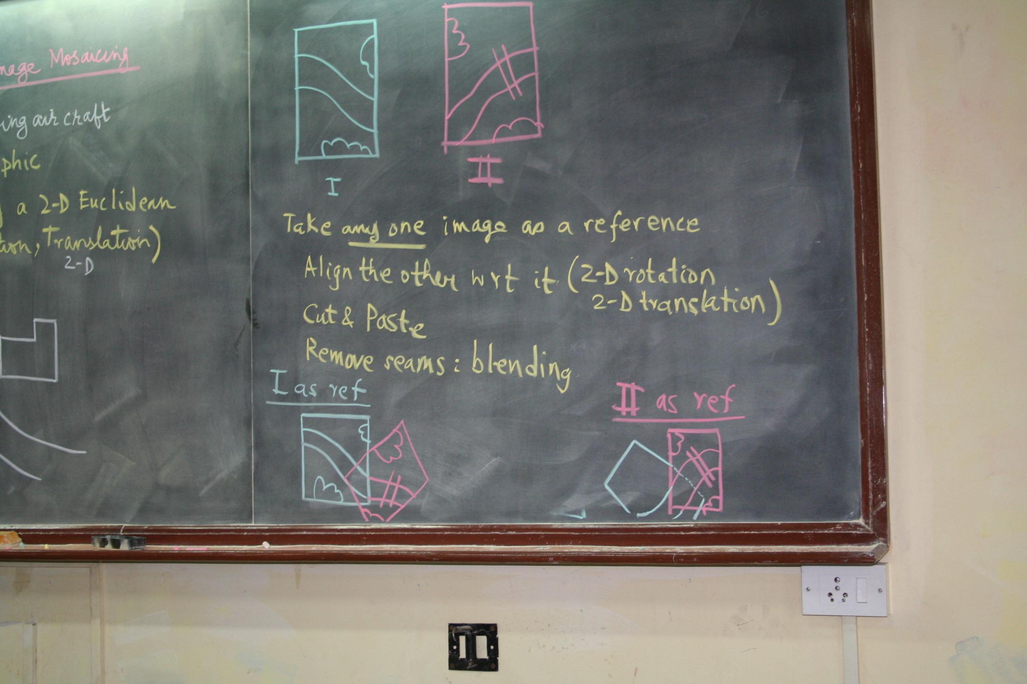
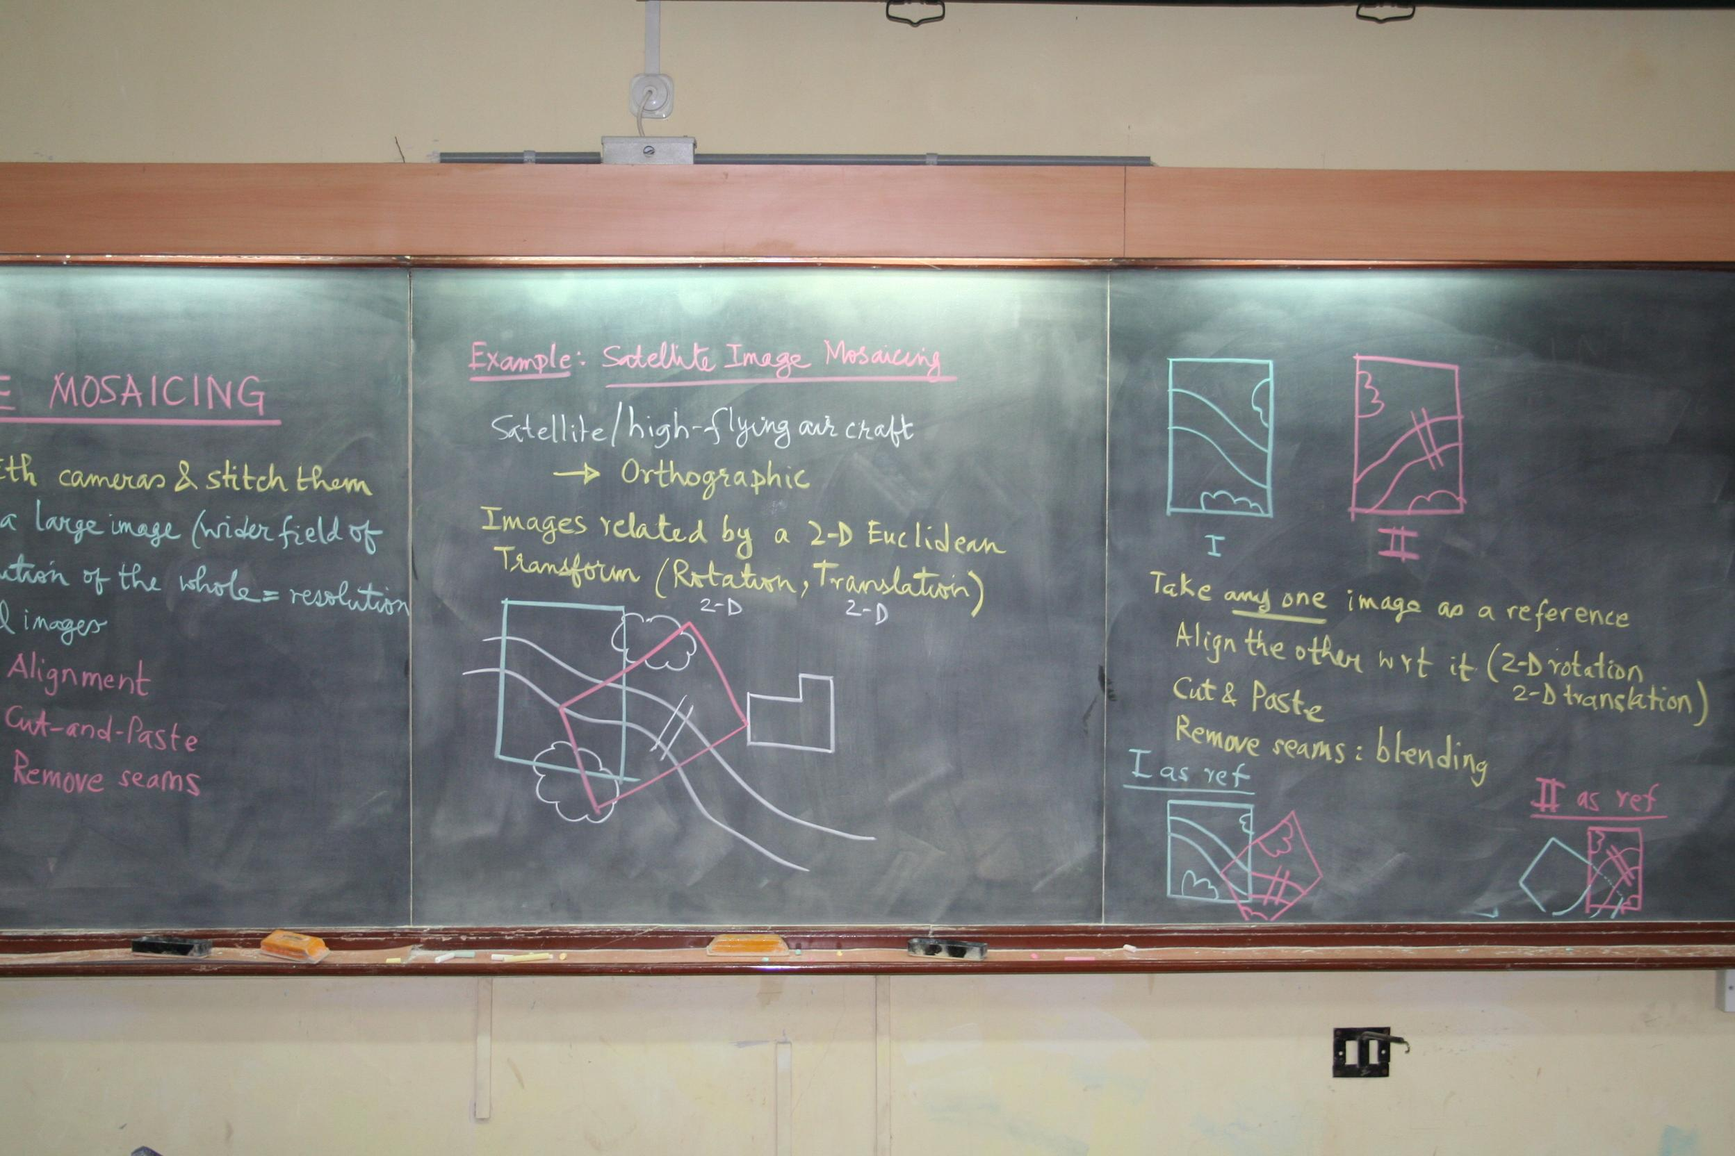
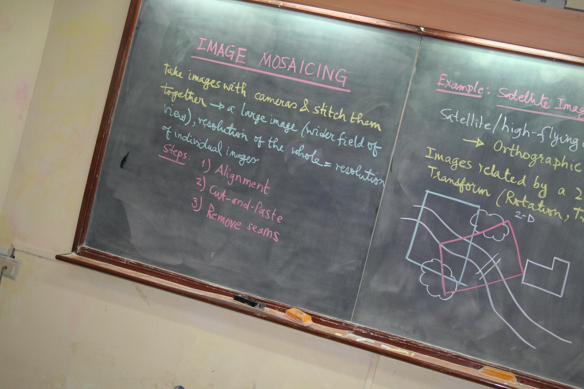
Procedure
5. Then we multiply boundary point of the perspective image with inverse homography matrix to get new boundary points
6. Then we take MINX MINY MAXX MAXY from boundary points of world image and the coordinates we calculated
7. Then we create an array of size of [(absolute)minx+maxx,(absolute)miny+maxy) and create a copy of previous world image at increased offset
8. Then traverse whole world map matrix to find the corresponding point by inverse mapping of homography matrix in perspective image and if there is a color value then we paste it to world image

Slide 6
Design Decision
Mosaicing is a technique which we have used to stitch images to get a complete image.
We gave world image, perspective image and all the coordinates as an input parameter, which undergo the process of inverse homography

Slide 7
Observation and Result

Slide 8
Observation
We observed…
After stitching there is some data loss as some data is overlapped or not stitched in its perfect position
As we stitch any two images there are some black spots (offset area which is not used) area which is created due to misalignment of another image at some angle. This increases the image size which has no useful data in black spots
Reason for doing inverse mapping...
While doing forward mapping we notice some small holes because we get some floating point values that are not present in the world image array. That’s why we have done the inverse mapping

Slide 9
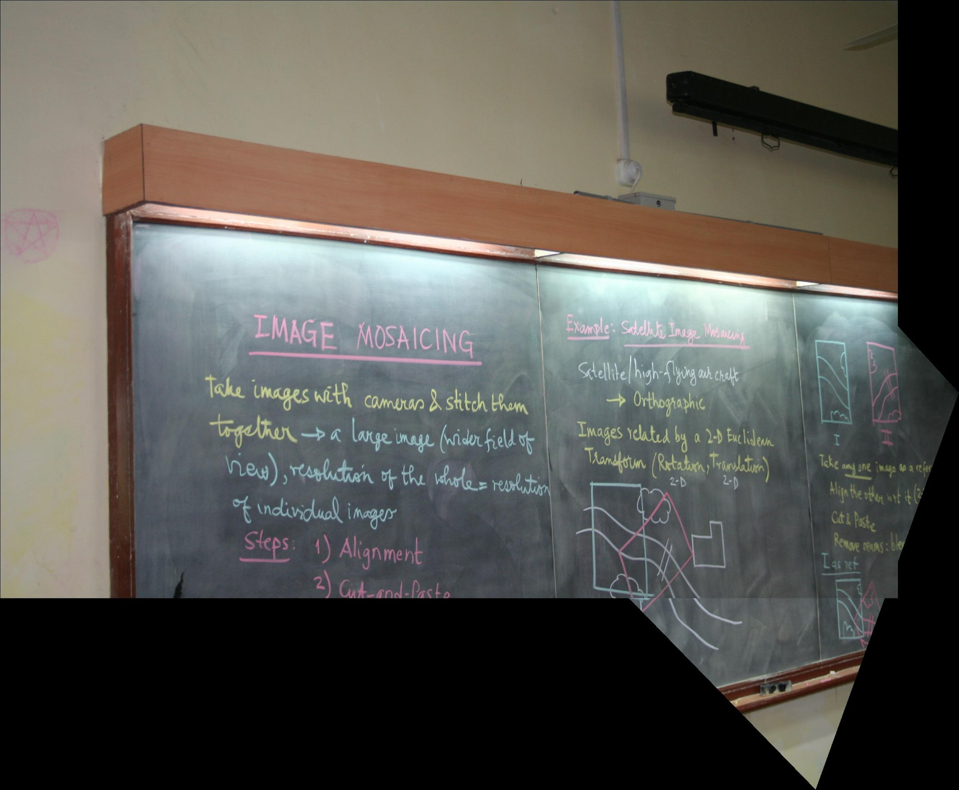
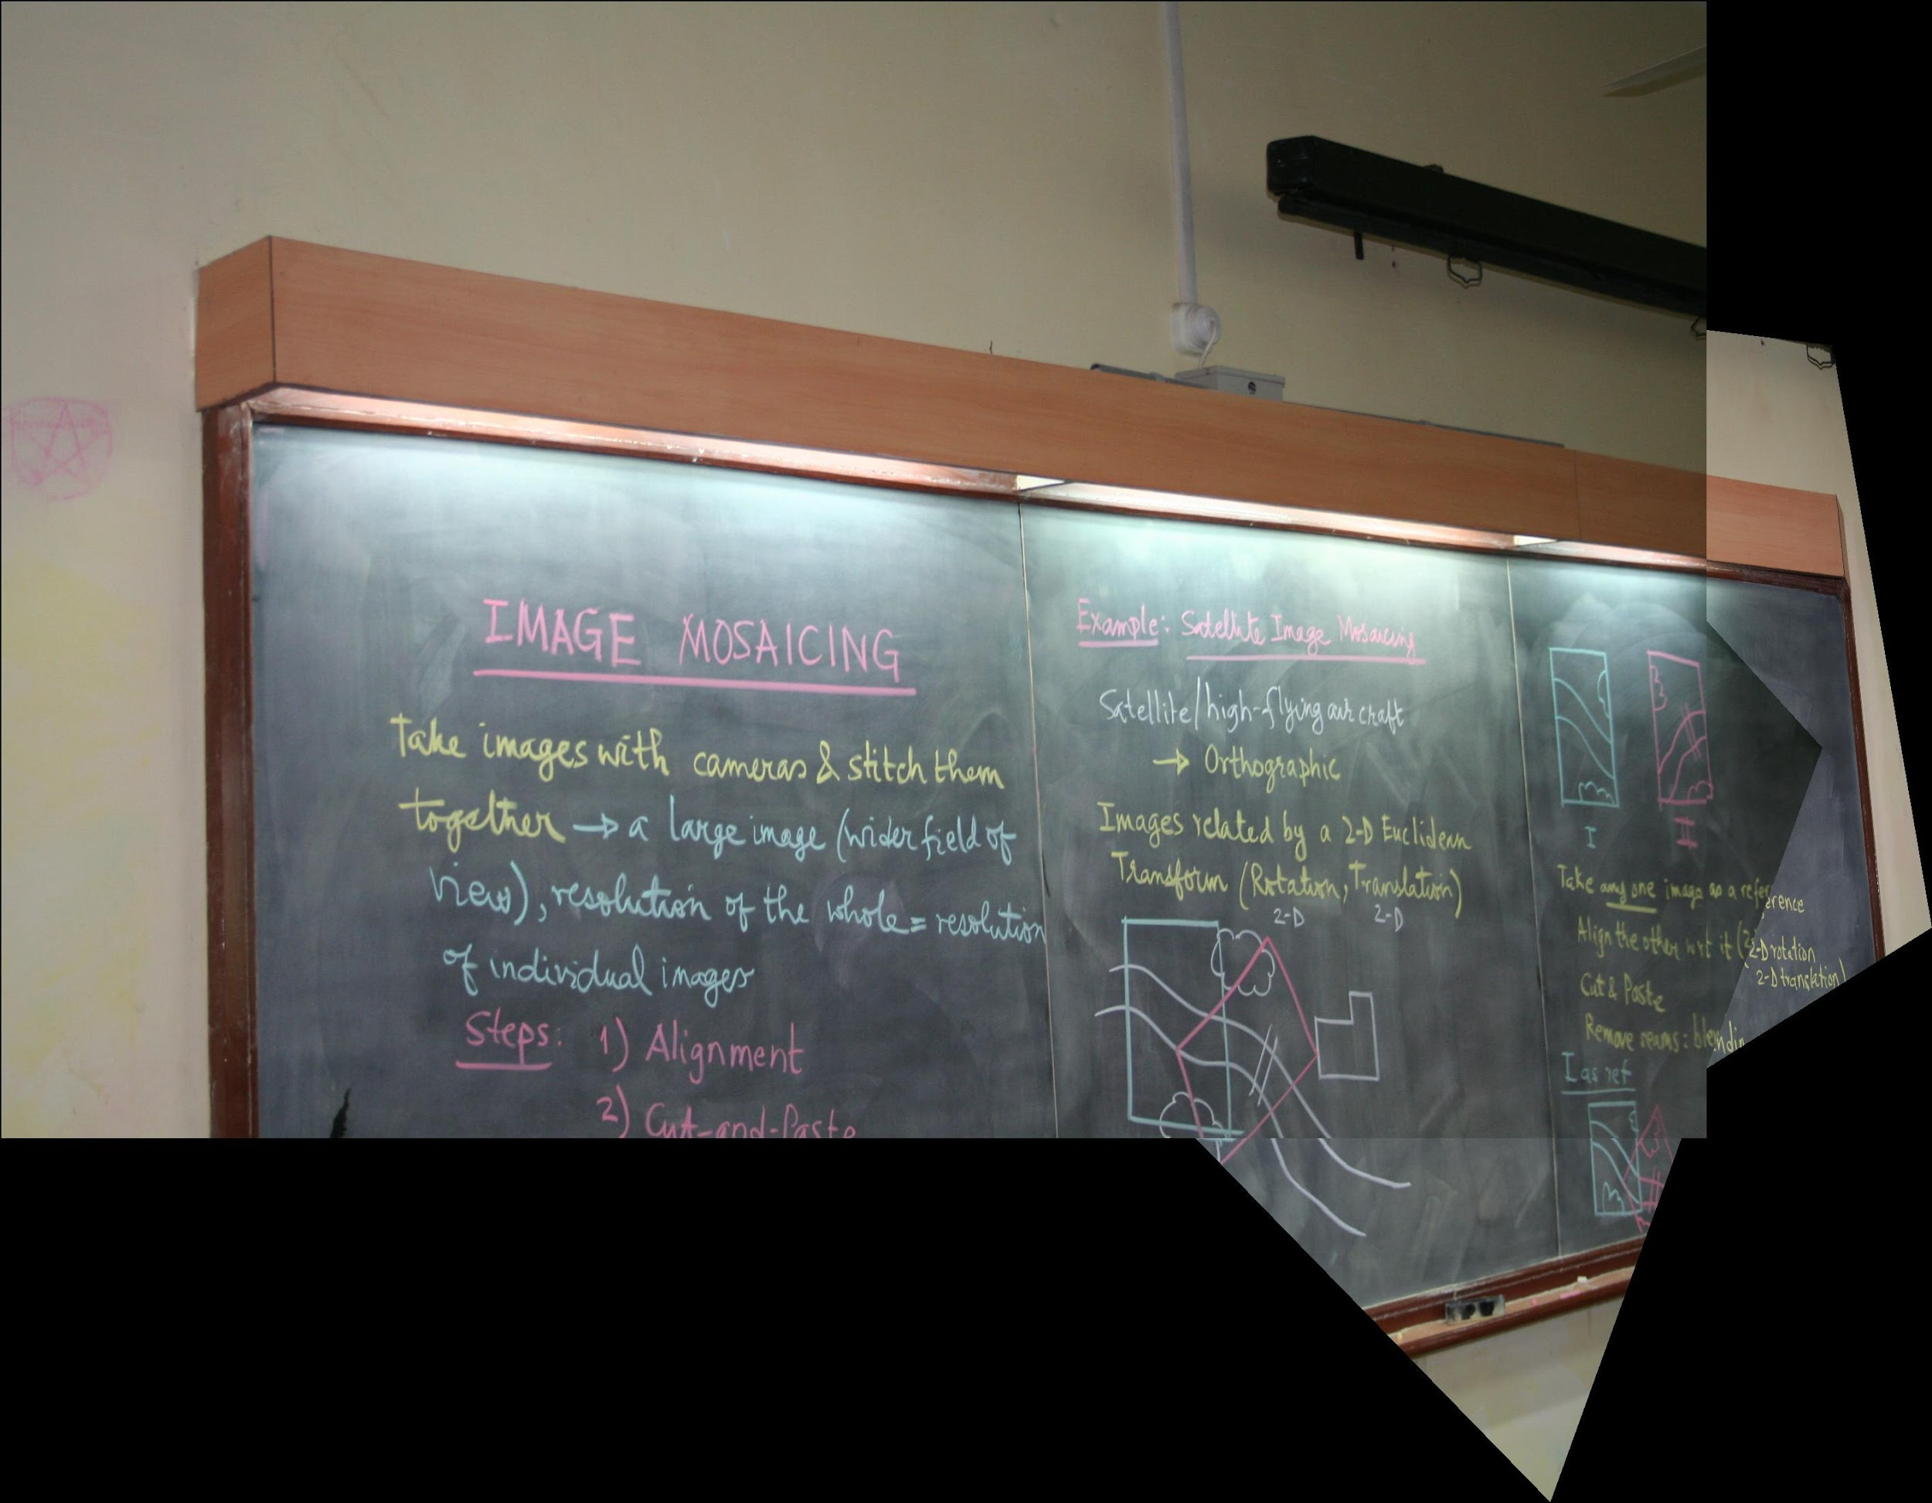
Image123
Image12

Slide 10
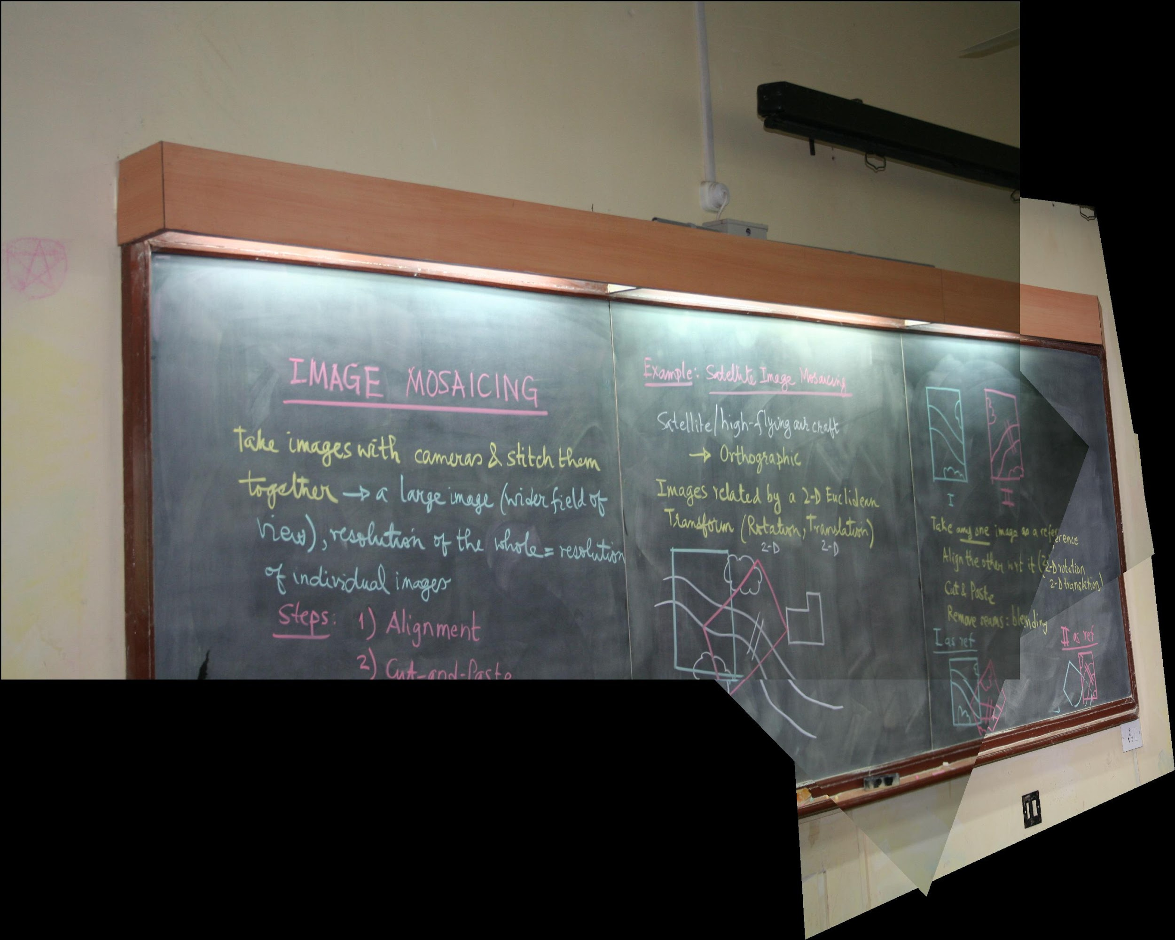
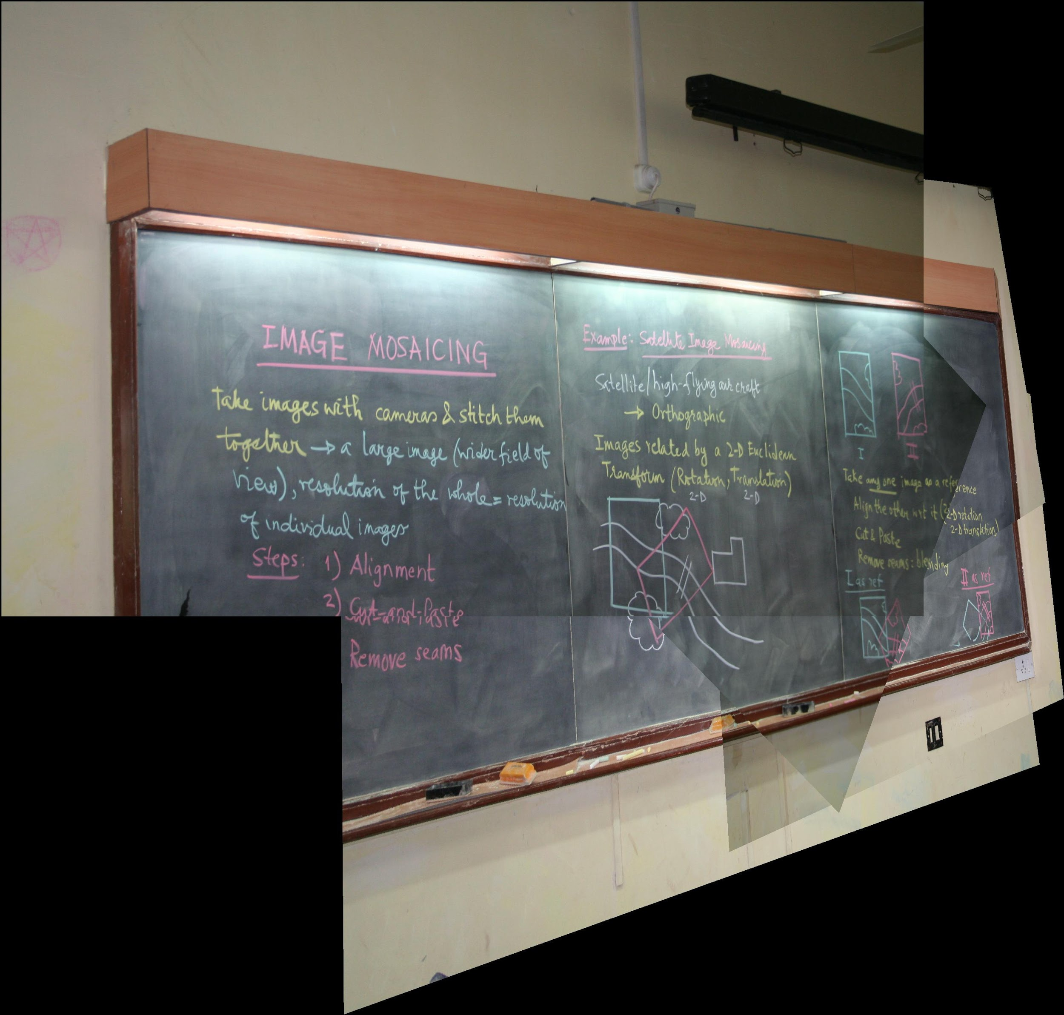
Image12345
Image1234

Slide 11
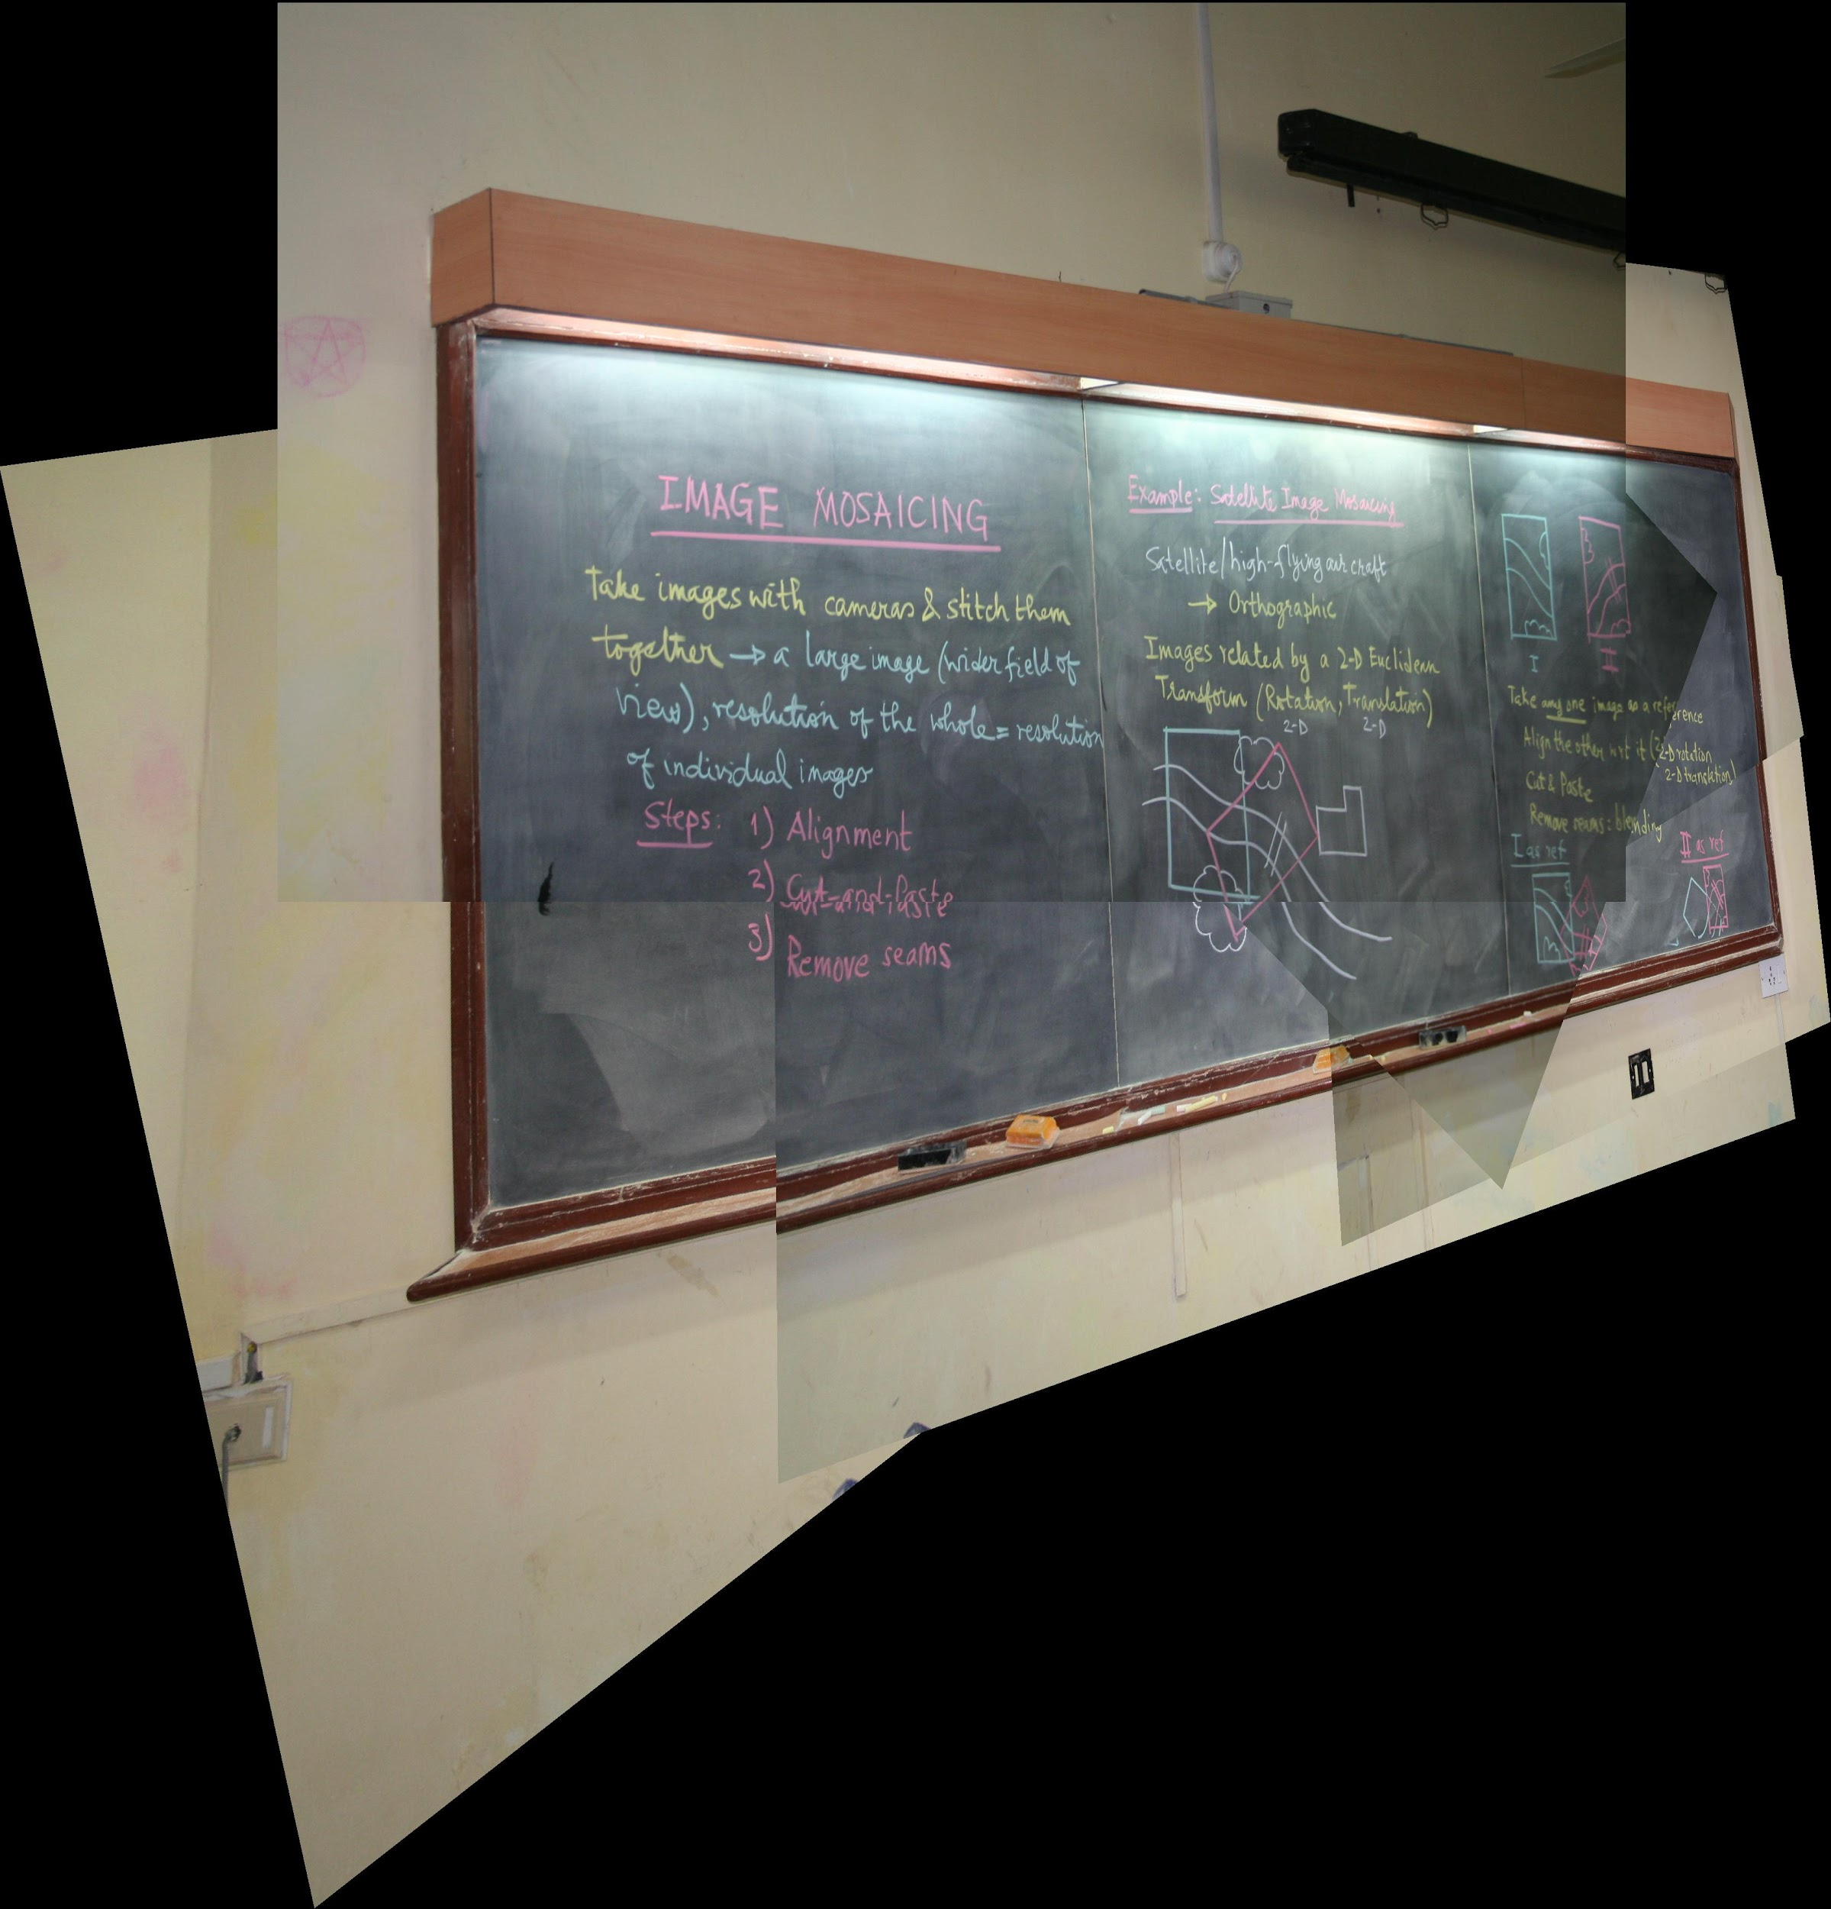
Resultant Image
Image12345

Slide 12
Thank You

